Slide 1



Beyond the Rankings: Understanding NSC League Tables, Equity, and Accountability
The unfairness of common performance indicators
Martin Gustafsson
March 2026

Slide 2
Contents
Before fairness, what about relevance?
How the ‘Matric pass rate’ remained king
Other indicators in the public domain
What might work best?

Slide 3
Before fairness, what about relevance?
The wider context…
A little over 51% of youths obtain a Grade 12 certificate in the year-end examinations as a full-time candidate. The figure becomes 65% if all equivalent qualifications are counted (has risen from 44% in 2008) [a,b].
Around 50% of youths qualify in a basic sense to enter university studies. Yet only around 10% obtain 40% in mathematics, while this and higher thresholds apply for two-thirds of first-year university places (around 120,000 places with such thresholds) [a].
40% of youths participate in some post-schooling, while 18% obtain a post-school qualification. Some 60% of youths entering the labour market thus draw only from formal education at the school level [a].

Slide 4

Before fairness, what about relevance? (contd.)
The wider context (contd.)
Official unemployment rate 40% for ages 25-34. Was 36% just before pandemic.
We have problem grappling with the relationship between schooling and our unemployment problem. Youth unemployment is very high, schooling outcomes are now about average for a middle-income country after a couple of decades of improvement. Official government reports [c] confirm unemployment is in part a result of a skills shortfall. But do education planners properly internalise the nature of this skill shortfall.

Slide 5
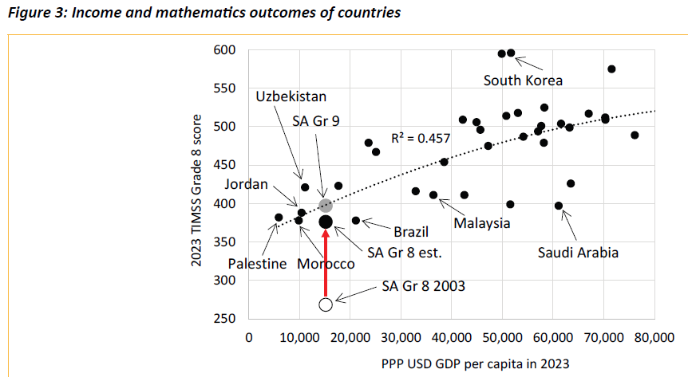
Before fairness, what about relevance? (contd.)
For a couple of decades there has been an acute awareness of how poorly South Africa performs in the international tests with respect to basic language and mathematics skills. The good news is that after around two decades of improvement, our quality of schooling matches that of other countries with a similar income per capita level. [d]

Slide 6
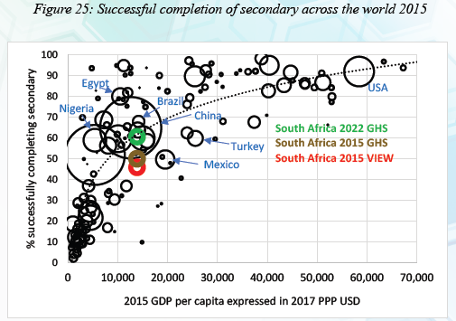
Before fairness, what about relevance? (contd.)
More good news. Despite the huge public attention given to our ‘schools dropout crisis’, successful completion of twelve years of schooling in South Africa is now on a par with that in similar countries. [a]

Slide 7
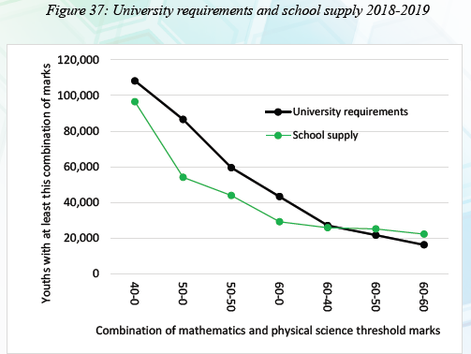
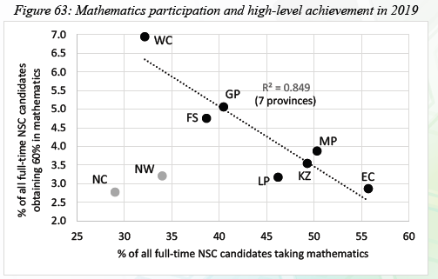
Before fairness, what about relevance? (contd.)
What does warrant more concern is the under-supply of high-level mathematics skills from schools, relative to university demand. What confuses matters is the idea that the way to improve this demand is simply to increase mathematics participation in schools. [a]

Slide 8

Before fairness, what about relevance? (contd.)
What about less academic indicators?
Experimentation with ‘inclinations assessments’ have occurred as part of the move to a standardised Grade 9 qualification. While the idea is appealing, there are various risks.
www.yenzacareers.com

Slide 9
How the ‘Matric pass rate’ remained king
The National Development Plan (released 2012) and accompanying government-wide national indicators have actually never paid much attention to the pass rate, nor set targets for it.
The perverse nature of the pass rate has been clear for years – e.g. it can be manipulated via subject choice and dropping out.
In 2022 the national examinations report introduced reporting on an ‘inclusive basket of criteria’ to offset the fixation with the pass rate.

Slide 10
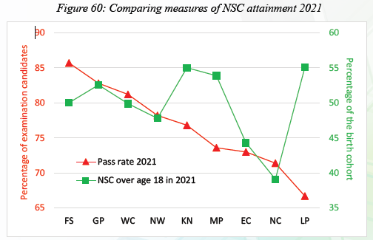
How the ‘Matric pass rate’ remained king (contd.)
The pass rate indicator clearly punishes those who keep learners in school up to Grade 12. See for instance KN, MP and LP. These problems would also exist the level of the school.

Slide 11
How the ‘Matric pass rate’ remained king (contd.)
Frequencies in the Parliamentary Monitoring Group website.

Slide 12
How the ‘Matric pass rate’ remained king (contd.)
How has the pass rate survived so well in the education policy debates?
It is computationally simple and alternatives (such as the ‘basket’) have not been clear enough.
Our politicians and journalists prioritise it.
It is an indicator that moves upward and hence suggests improvements (even while exposing e.g. politicians to accusations of spin).
The ‘Matric’ has in the past carried considerable power in the labour market.
The system continues to publish school-level pass rates as if this statistic is adequate for across-school comparison.

Slide 13
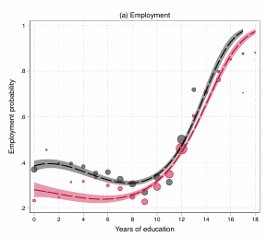
How the ‘Matric pass rate’ remained king (contd.)
Better employment prospects for all levels of education in 2001, not just Matric level. [e]

Slide 14

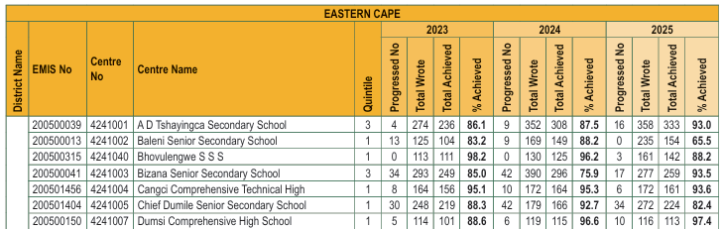
How the ‘Matric pass rate’ remained king (contd.)
The closest we have to a pass rate league table. School quintile is included, but how to use it in evaluating schools not clear.

Slide 15
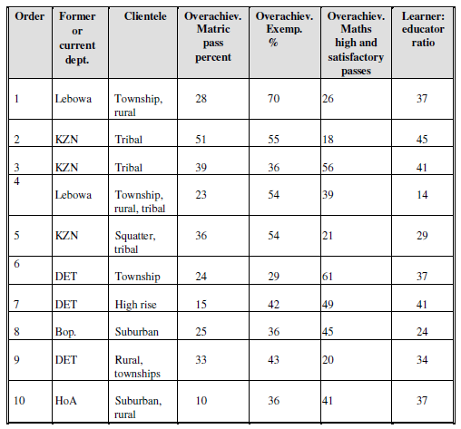
Other indicators in the public domain
As early as 1998 Crouch and Mabogoane tested a fairer version of the pass rate which controlled for things like school resource endowments. [f]
Their method arrived at a top ten school achievers with these characteristics.

Slide 16
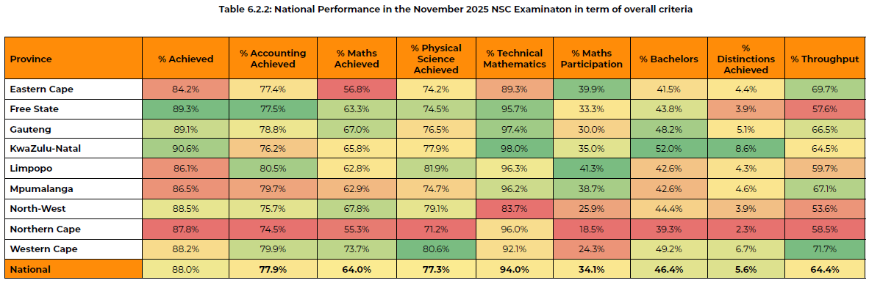
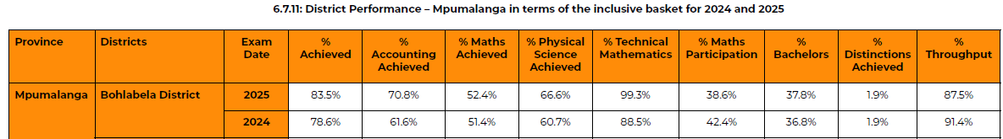
Other indicators in the public domain (contd.)
Inclusive Basket of Criteria
In the official NSC report. It has been difficult to popularise this. In part this is due to the absence of a properly documented rationale, with analysis backing the selection of indicators.

Slide 17


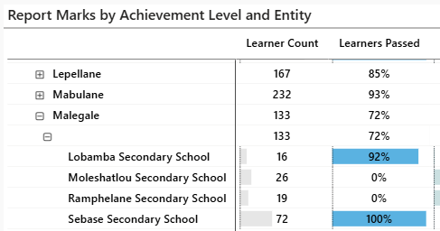

Other indicators in the public domain (contd.)
Data Driven Districts (DDD) is a massive and costly partnership-based undertaking covering 8 provinces. This is an obvious vehicle for school-level measures in future. Currently, information is often not well presented, though proposals have been made. [g]

Slide 18
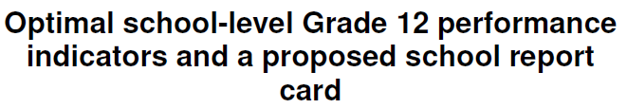

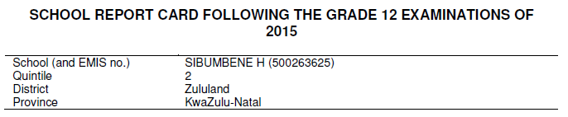

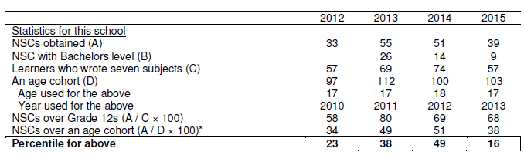

Other indicators in the public domain (contd.)

Slide 19
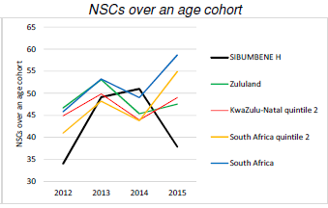
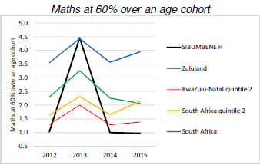
Other indicators in the public domain (contd.)
Graphs that would accompany the 7-page explanation-rich school report card. [g]
The age cohort used for the denominator is the largest age cohort seen in a recent year.

Slide 20
Other indicators in the public domain (contd.)
The only Grade 12 indicator in government’s five-year plan (the ‘MTDP’) is learners obtaining 60% in mathematics (and same for physical sciences).
This has been reported on for some years in the official NSC report.
Given only around 40,000 achieve this per year (some 5% of youths), this indicator may seem narrow. But it is strategically important where ‘skills shortages continue to choke the South African economy’ (from the NDP).

Slide 21
Other indicators in the public domain (contd.)
Given South Africa’s history, breaking indicators down by race is arguably as important as by some measure of socio-economic status (SES). Race data are moreover easily accessible and relatively unambiguous.
Better enrolment data now allow us to measure e.g. what percentage of black learners ever at school obtain 60% in mathematics in Grade 12. This provides very different rankings to measures that include everyone.

Slide 22
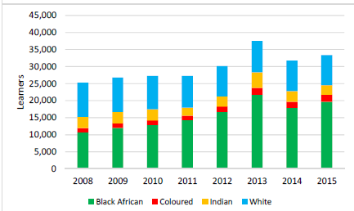
Other indicators in the public domain (contd.)
White and Indian youths are five times as likely to obtain 60% in mathematics compared to black African and coloured youths. The situation has been gradually improving over time. [a,h]

Slide 23
Other indicators in the public domain (contd.)
2025 NSC report has these district rankings – all youths on left, black youths on right.

Slide 24
Other indicators in the public domain (contd.)
Capricorn South. Below average pass rate, top black mathematics achievement.
Johannesburg West. Number 1 pass rate, only average black mathematics achievement.

Slide 25
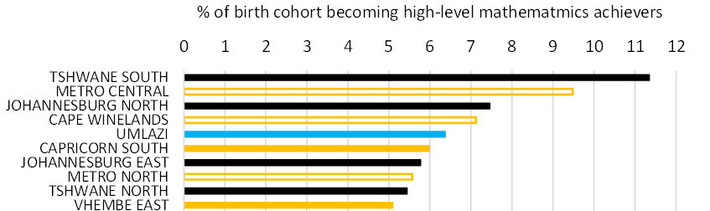
Other indicators in the public domain (contd.)
Here are the top ten districts. Specifically, this is learners aged 15 in 2018 (this would be virtually the entire age 15 population) who obtained 60% or more in mathematics in the NSC examinations in any year up to 2024. The district used is the one the learner was in when aged 15.
Four of the ten are in Gauteng. Top is Tshwane South with 11.4%.

Slide 26
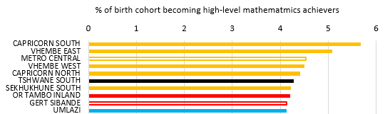
Other indicators in the public domain (contd.)
What happens if we focus only on black African and coloured learners, who are at a clear disadvantage across the system as a whole?
Now five of the ten are in Limpopo. Top is Capricorn South with 5.7%.

Slide 27
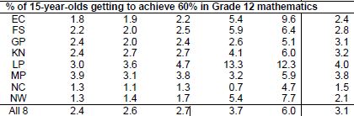
What might work best for schools?
Regarding SES, how meaningful are school quintiles?
Actually, still quite meaningful. (From DBE report in the pipeline.)

Slide 28
What I would advise the Minister, if asked
What might work best for schools? (contd.)
Use the 2017 proposal, with some adaptations…
For the attainment of NSC category, include a line with NSCs, or the equivalent from a public TVET college, of any learner who was in the school. The same could be done with e.g. attainment of 60% in mathematics for an NSC examination conducted at an adult centre.
Explore alternatives to school quintile, such as percentage of learners in the school receiving a child support grant (CSG).
Use race as an important reporting dimension, but not at the school level. Do this for the district level and above. The fact that 80% of Grade 12 learners are in schools where there are no white or Indian learners reduces the effectiveness of the race dimension for schools.

Slide 29
Publicly available sources
Crouch, L. & Mabogoane, T. (1998). When the residuals matter more than the coefficients: An educational perspective. Journal of Studies in Economics and Econometrics, 22(2). [f]
Department of Basic Education (2024). Review of progress in the basic education sector to 2024: Analysis of key statistics. Pretoria. [a]
Department of Basic Education (2025). Action Plan to 2029: Towards the realisation of Schooling 2030. Pretoria. [d]
Department of Basic Education (2026). 2025 National Senior Certificate: Examination report. Pretoria. [b]
Gustafsson, M. (2016). Understanding trends in high-level achievement in Grade 12 mathematics and physical science. Pretoria: Department of Basic Education. [h]
Khuluvhe, N., Bhorat, H., Oosthuizen, M., Asmal, Z. et al (2022). Skills supply and demand in South Africa. Pretoria: Department of Higher Education and Training. [c]
Köhler, T. (2024). A Paradox of progress: Rising education and unequal labour market returns in post-Apartheid South Africa. Stellenbosch: Stellenbosch University. [e]
National Treasury (2017). Optimal school-level Grade 12 performance indicators and a proposed school report card. Pretoria. [g]

